Slide 1
8.1 General Linear Transformation
Dr. Biswambhar Rakshit

Slide 2
Definition
If T: V→W is a function from a vector space V into a vector space W, then T is called a linear transformation from V to W if for all vectors u and v in V and all scalors c
T (u+v) = T (u) + T (v)
T (cu) = cT (u)
In the special case where V=W, the linear transformation T:V→V is called a linear operator on V.

Slide 3
Example 1 Zero Transformation
The mapping T:V→W such that T (v)=0 for every v in V is a linear transformation called the zero transformation. To see that T is linear, observe that
T (u+v) = 0. T (u) = 0, T (v) = 0. And T (k u) = 0
Therefore,
T (u+v) =T (u) +T (v) and T (k u) = kT (u)

Slide 4
Example 2 Identity Operator
The mapping I: V→V defined by I (v) = v is called the identify operator on V.

Slide 5
Example 3 Dilation and Contraction operators
Let V be any vector space and k any fixed scalar. The function T:V→V defined by
T (v) = k v
is linear operator on V.
Dilation: k > 1
Contraction: 0 < k < 1

Slide 6
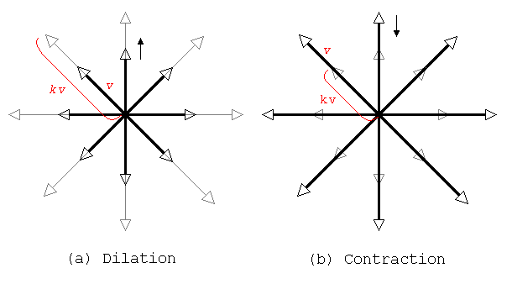
Dilation and Contraction operators

Slide 7
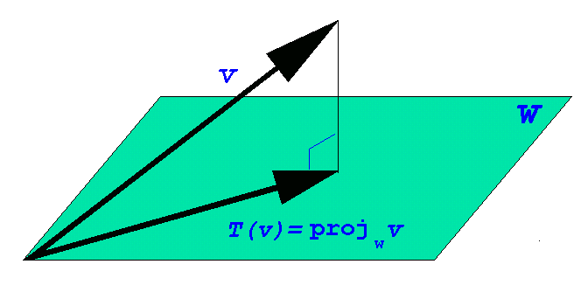
Example 4 Orthogonal Projections
Suppose that W is a finite-dimensional subspace of an inner product space V ; then the orthogonal projection of V onto W is the transformation defined by
T (v ) = projwv

Slide 8
Example 5 A Linear Transformation from a space V to R^{n}
Let S = {w₁ , w₂ , …, w_{n} } be a basis for an n-dimensional vector space V, and let
(v)_{s} = (k_{1,} k_{2,} …, k_{n} )
Be the coordinate vector relative to S of a vector v in V thus
v = k₁ w + k₂ w₂ + …+ k_{n} w_{n}
Define T: V→R^{n} to be the function that maps v into its coordinate vector relative to S; that is,
T (v) = (v)_{s} = (k_{1,} k_{2,} …, k_{n} )

Slide 9
The function T is linear transformation. To see that this is so, suppose that u and v are vectors in V and that
u = c₁ w₁+ c₂ w₂+ …+ c_{n} w_{n} and
v = d₁ w₁+ d₂ w₂+ …+ d_{n} w_{n}
Thus,
(u)_{s} = (c_{1,} c_{2,} …, c_{n} ) and (v)_{s} = (d_{1,} d_{2,} …, d_{n} )
But
u+v = (c₁+d₁) w₁+ (c₂+d₂) w₂+…+ (c_{n}+d_{n}) w_{n}
k u = (kc₁) w₁ +(kc₂) w₂ +…+ (kc_{n}) w_{n}
So that
(u+v)_{s} = (c₁+d_{1,} c₂+d₂ …, c_{n}+d_{n} )
(k u)_{s} = (kc_{1,} kc_{2,} …, kc_{n} )

Slide 10
Therefore,
(u+v)_{s} = (u)_{s} + (v)_{s} and (k u)_{s} = k (u)_{s}
Expressing these equations of T, we obtain
T (u+v) = T (u) + T (v) and T (k u) = kT (u)
Which shows that T is a linear transformation.
REMARK. The computations in preceding example could just as well have been performed using coordinate matrices rather than coordinate vectors; that is ,
[u+v] = [u]_{s} +[v]_{s} and [k u]_{s} = k [u]_{s}

Slide 11
Example 6 A Linear Transformation from p_{n} to p_{n+1}
Let p = p(x) = C₀ X + C₁X² + …+ C_{n}X ^{n} be a polynomial in P_{n} , and define the function T: P_{n} → P_{n+1} by
T (p) = T (p(x)) = xp(x)= C₀ X + C₁X² + …+ C_{n}X ^{n+1}
The function T is a linear transformation, since for any scalar k and any polynomials p₁ and p₂ in P_{n} we have
T (p₁+p₂) = T (p₁(x) + p₂ (x)) = x (p₁(x)+p₂ (x))
= x p₁ (x) + x p₂ (x) = T (p₁) +T (p₂)
and
T (k p) = T (k p(x)) = x (k p(x))= k (x p(x))= k T(p)

Slide 12
Example 7 A linear Operator on P_{n}
Let p = p(x) = c₀ X + c₁X² + …+ c_{n}X ^{n} be a polynomial in P_{n} , and let a and b be any scalars. We leave it as an exercise to show that the function T defined by
T (p) = T(p(x)) = p (ax+b) = c₀ + c₁ (ax+b) + …+ c_{n}(ax+b) ^{n}
is a linear operator. For example, if ax+b = 3x – 5, then T: P₂ → P₂ would be the linear operator given by the formula
T (c₀ + c₁x+ c₂ x² ) = c₀ + c₁ (3x-5) + c₂ (3x-5) ²

Slide 13
Example 8 A Transformation That Is Not Linear
Let T:M_{nn} →R be the transformation that maps an n × n matrix into its determinant; that is,
T (A) = det (A)
If n>1, then this transformation does not satisfy either of the properties required of a linear transformation. For example, we saw Example 1 of Section 2.3 that
det (A₁+A₂) ≠ det (A₁) + det (A₂)
in general. Moreover, det (cA) =C ^{n} det (A), so
det (cA) ≠ c det (A)
in general. Thus, T is not linear transformation.

Slide 14
Properties of Linear Transformation
If T:V→W is a linear transformation, then for any vectors v₁ and v₂ in V and any scalars c₁ and c₂ , we have
T (c₁ v₁ + c₂ v₂) = T (c₁ v₁ ) + T (c₂ v₂) = c₁T (v₁ ) + c₂T (v₂)
and more generally, if v₁ , v₂ , …, v_{n} are vectors in V and c₁ , c₂ , …, c_{n} are scalars, then
T (c₁ v₁ + c₂ v₂ +…+ c_{n} v_{n} ) =
c₁T (v₁ ) + c₂T ( v₂ ) +…+ c_{n}T ( v_{n} ) (1)
Formula (1) is sometimes described by saying that linear transformations preserve linear combinations.

Slide 15
Theorem 8.1.1
If T:V→W is a linear transformation, then:
T (0) = 0
T (-v ) = -T (v ) for all v in V
T (v-w ) = T (v ) - T (w) for all v and w in V

Slide 16
Proof.
(a) Let v be any vector in V. Since 0v=0, we have
T (0)=T (0v)=0T (v)=0
(b) T (-v) = T ((-1)v) = (-1)T (v)=-T (v)
(c) v-w=v+(-1)w; thus,
T (v-w)= T (v + (-1)w) = T (v) + (-1)T (w)
= T (v) -T (w)

Slide 17
Finding Linear Transformations from Images of Basis
If T:V→W is a linear transformation, and if {v₁ , v₂ , …, v_{n} } is any basis for V, then the image T (v) of any vector v in V can be calculated from images
T (v₁), T (v₂), …, T (v_{n})
of the basis vectors. This can be done by first expressing v as a linear combination of the basis vectors, say
v = c₁ v₁+ c₂ v₂+ …+ c_{n} v_{n}
and then using Formula(1) to write
T (v) = c₁ T (v₁) + c₂ T (v₂) + … + c_{n} T (v_{n})
In words, a linear transformation is completely determined by its images of any basis vectors.

Slide 18
Computing with Images of Basis Vectors
Consider the basis S = {v₁ , v₂ , v₃ } for R³ , where v₁ = (1,1,1), v₂ =(1,1,0), and v₃ = (1,0,0). Let T: R^{3 →}R² be the linear transformation such that
T (v₁)=(1,0), T (v₂)=(2,-1), T (v₃)=(4,3)
Find a formula for T (x₁ , x₂ , x₃ ); then use this formula to compute T (2,-3,5).

Slide 19
Solution.
We first express x = (x₁ , x₂ , x₃ ) as a linear combination of v₁ =(1,1,1), v₂ =(1,1,0), and v₃ = (1,0,0). If we write
(x₁ , x₂ , x₃ ) = c₁ (1,1,1) + c₂ (1,1,0) + c₃ (1,0,0)
then on equating corresponding components we obtain
c₁ + c₂ + c₃ = x₁
c₁ + c₂ = x₂
c₁ = x₃

Slide 20
which yields c₁ = x₃ , c₂ = x₂ - x₃ , c₃ = x₁ - x₂ , so that
(x₁ , x₂ , x₃ ) = x₃ (1,1,1) + (x₂ - x₃ ) (1,1,0) + (x₁ - x₂ ) (1,0,0)
= x₃ v₁ + (x₂ - x₃ ) v₂ + (x₁ - x₂ ) v₃
Thus,
T (x₁ , x₂ , x₃ ) = x₃ T (v₁) + (x₂ - x₃ ) T (v₂) + (x₁ - x₂ ) T (v₃)
= x₃ (1,0) + (x₂ - x₃ ) (2,-1) + (x₁ - x₂ ) (4,3)
= (4x₁ -2x₂ -x₃ , 3x₁ - 4x₂ +x₃)
From this formula we obtain
T (2 , -3 , 5 ) =(9,23)

Slide 21
Composition of T₂ with T₁
If T₁ :U→V and T₂ :V→W are linear transformations, the composition of T₂ with T₁ , denoted by T₂ 。T₁ (read “T₂ circle T₁ ”), is the function defined by the formula
(T₂ 。T₁ )(u) = T₂ (T₁ (u)) (2)
where u is a vector in U

Slide 22
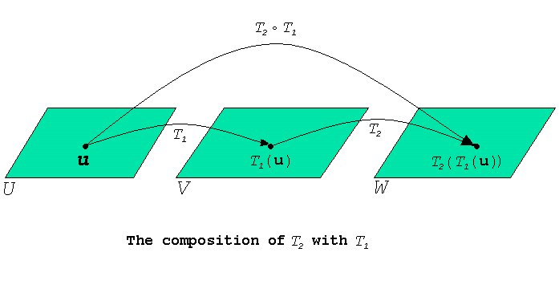

Slide 23
Theorem 8.1.2
If T₁ :U→V and T₂ :V→W are linear transformations, then (T₂ 。T₁ ):U→W is also a linear transformation.

Slide 24
Proof. If u and v are vectors in U and c is a scalar, then it follows from (2) and the linearity of T₁ andT₂ that
(T₂ 。T₁ )(u+v) = T₂ (T₁(u+v)) = T₂ (T₁(u)+T₁ (v))
= T₂ (T₁(u)) + T₂ (T₁(v))
= (T₂ 。T₁ )(u) + (T₂ 。T₁ )(v)
and
(T₂ 。T₁ )(c u) = T₂ (T₁ (c u)) = T₂ (cT₁(u))
= cT₂ (T₁ (u)) = c (T₂ 。T₁ )(u)
Thus, T₂ 。T₁ satisfies the two requirements of a linear transformation.

Slide 25
Composition of Linear Transformations
Let T₁ : P₁ → P₂ and T₂ : P₂ → P₂ be the linear transformations given by the formulas
T₁(p(x)) = xp(x) and T₂ (p(x)) = p (2x+4)
Then the composition is (T₂ 。T₁ ): P₁ → P₂ is given by the formula
(T₂ 。T₁ )(p(x)) = (T₂)(T₁(p(x))) = T₂ (xp(x)) = (2x+4)p (2x+4)
In particular, if p(x) = c₀ + c₁ x, then
(T₂ 。T₁ )(p(x)) = (T₂ 。T₁ )(c₀ + c₁ x)
= (2x+4) (c₀ + c₁ (2x+4))
= c₀ (2x+4) + c₁ (2x+4)²

Slide 26
Composition with the Identify Operator
If T:V→V is any linear operator, and if I:V→V is the identity operator, then for all vectors v in V we have
(T。I )(v) = T (I (v)) = T (v)
(I。T )(v) = I (T (v)) = T (v)
It follows that T。I and I。T are the same as T ; that is,
T。I=T and I。T = T (3)
We conclude this section by noting that compositions can be defined for more than two linear transformations. For example, if
T₁ : U → V and T₂ : V→ W ,and T₃ : W→ Y

Slide 27
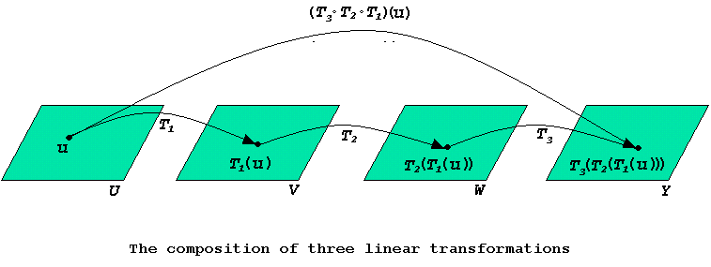
are linear transformations, then the composition T₃。T₂。T₁ is defined by
(T₃。T₂。T₁ )(u) = T₃ (T₂ (T₁ (u))) (4)

